Slide 1


Slide 2

Creating a WordPress Website
Is WordPress for You?

Slide 3

Getting started with wordpress
https://wordpress.com/

Slide 4
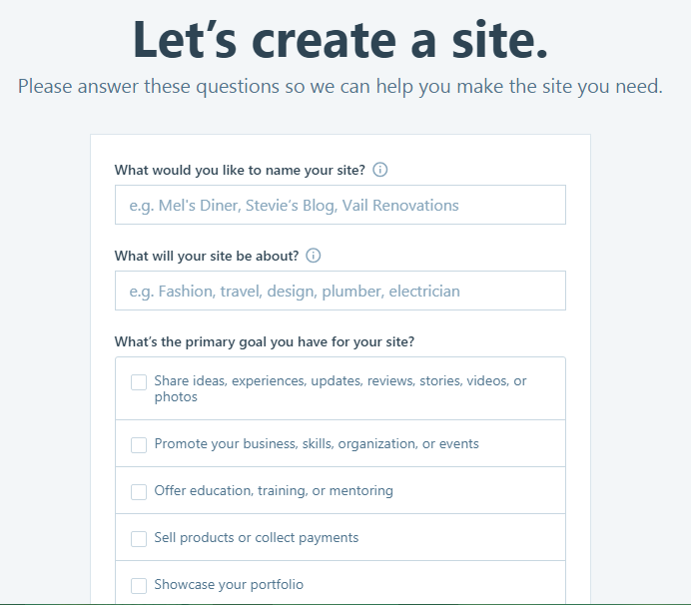
Sign Up on wordpress
Click on sign up
You will see the given page

Slide 5
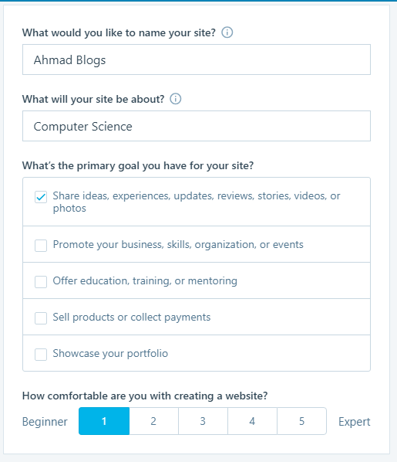
Registring to wordpress
Fill the form
Press Continue button

Slide 6
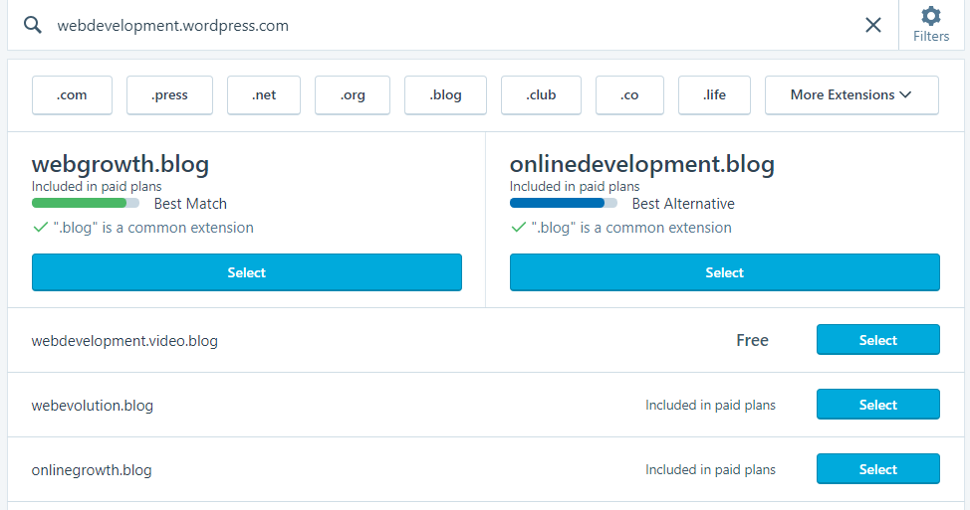
Selecting URL for your Site
Enter any URL having wordpress
Select the Free one

Slide 7
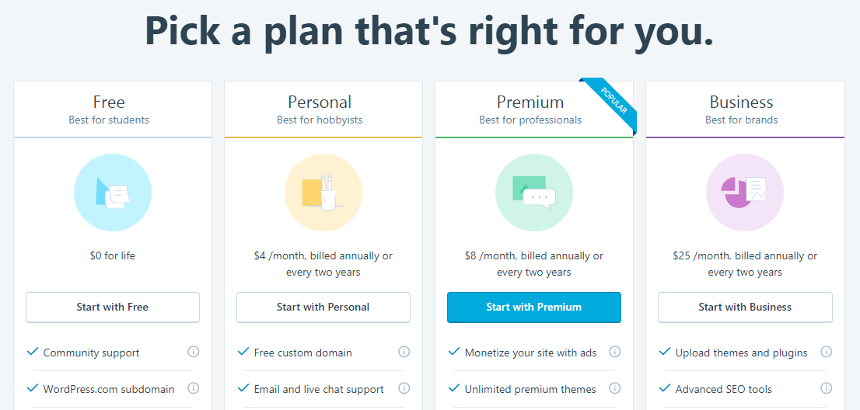
Select a Free URL
Start with the Free option

Slide 8
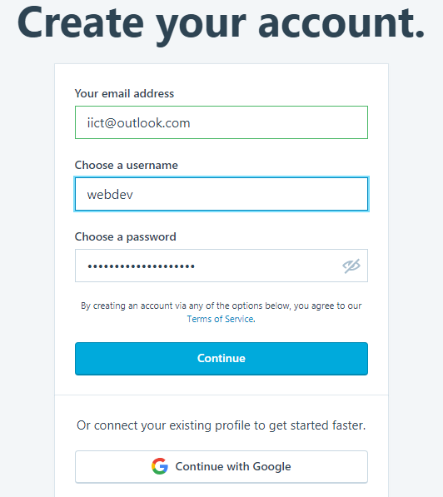
Create your account by entering email address, choose a user name and a password
You may also get login by clicking on Continue with google
Then Continue

Slide 9
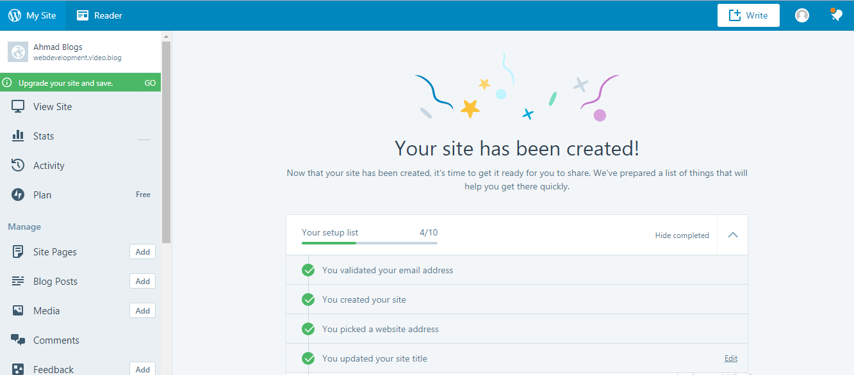
After confirming your email you will see the following Admin page https://wordpress.com/checklist/webdevelopment.video.blog
This is your website URL
Webdevelopment.video.blog
Remember this is Admin Page

Slide 10
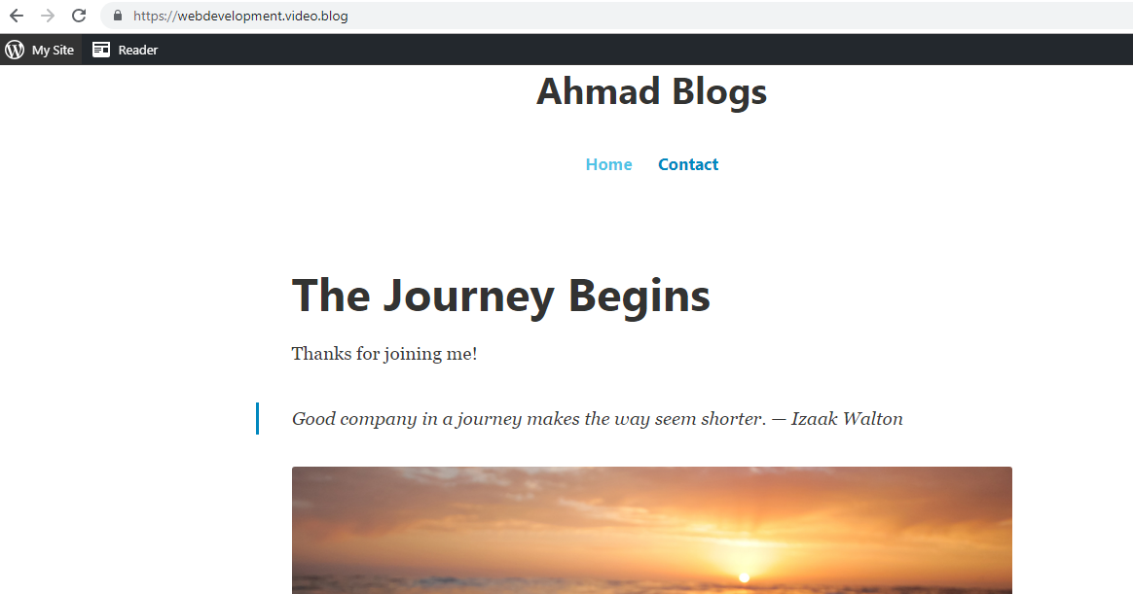
Now go to next page and write your URL in address bar
You will see your URL here.

Slide 11
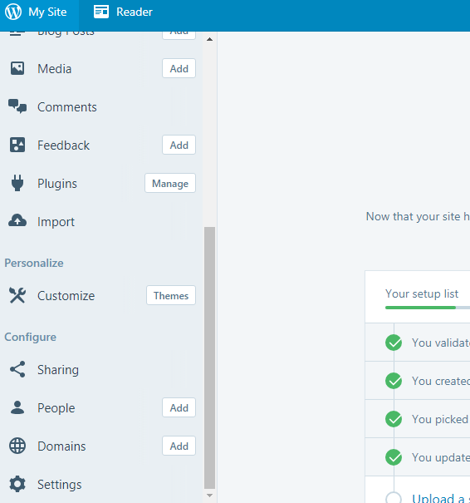
Changing Theme of your site
Go back to the Admin page
You will see Customize option on the left click on it
You will see many themes. Select a free theme and activate it. I chose Dara (name of the theme) theme.

Slide 12
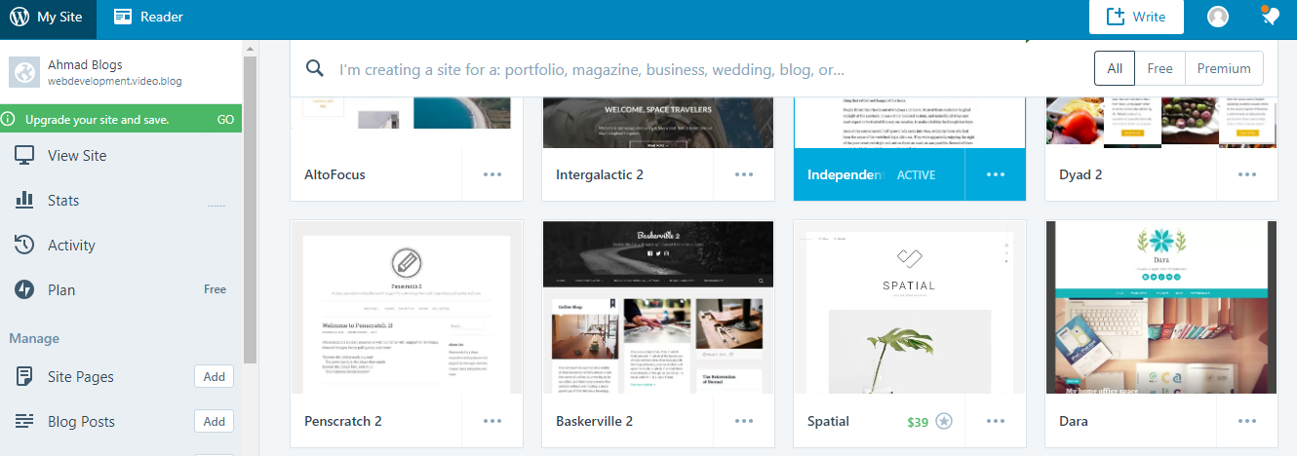
This one

Slide 13
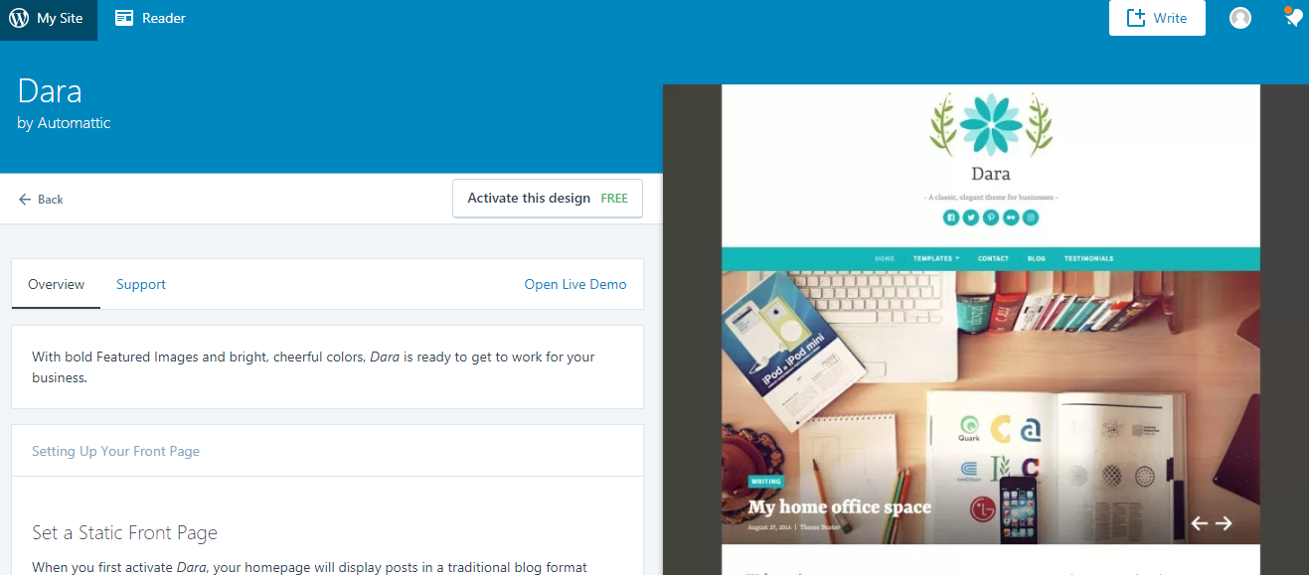
Activating a FREE theme
Activate theme from here.

Slide 14
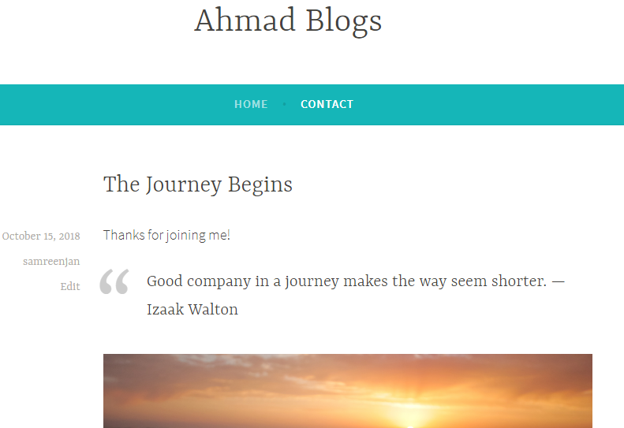
After activating and going to your site (https://webdevelopment.video.blog/) you will see the activated theme.

Slide 15
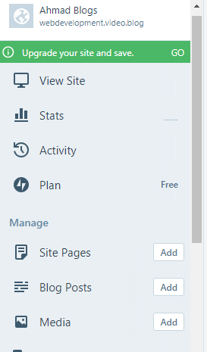
Adding a blog/post to your page
Again go to Admin page and go to Blog Posts and click on Add
You will see an editor page just like MS Word. (Given in next slide)

Slide 16
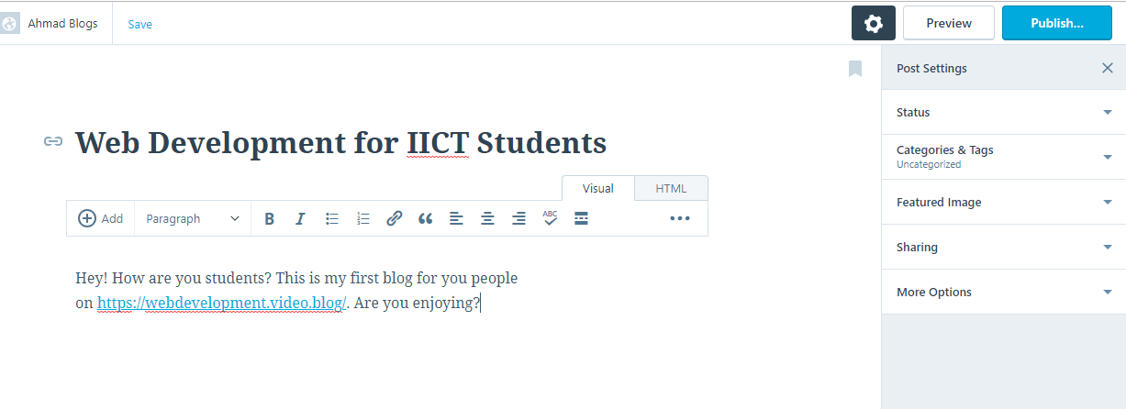
How to add a blog/post to your site?
Write any thing you want to post on your page and then click on Publish

Slide 17

You will see the post on your site as following

Slide 18
Now its your turn to explore the wordpress.
You can also add
Pages
Media
Comments
Can Site pages in your blog
Even you can share your post on any Social Media platform from your site.

